Slide 1
CZ1115
MINI-PROJECT
FS2, GROUP 3
ROYDON, BRYAN, JUN JIE
Notes:
Hi this video is going to present on our mini-project for CZ1115.Member of this group consist of Roydon, Bryan and Jun Jie.

Slide 2
TABLE OF CONTENTS
DATA ANALYSIS
EXPLORATORY DATA ANALYSIS
OUTCOME
1
3
5
2
4
6
PROBLEM ANALYSIS AND DATA CLEANING
MODELS AND EXTRA TECHNIQUES
INSIGHTS AND RECOMMENDATIONS
Notes:
The contents will consist on Data Analysis,Problem Analysis and Data cleaning,Exploratory Data analysis,Models and extra techniques,Outcome and lastly Insight and recommendations.

Slide 3
PROBLEM DEFINITION
How do we use features in datasets to predict revenue?
Notes:
Thus our current practical motivation is can we predict movie revenu. And can we solve the problem using data obtained from movies?

Slide 4


TMDB’S
MOVIE DATASET
Notes:
The dataset we used was the TMDB’S Movie Dataset.

Slide 5
DATA & EXPLORATORY ANALYSIS
Data Collection, Curation and Preparation
Notes:
First we would like to explain about data & exploratory analysis.

Slide 6
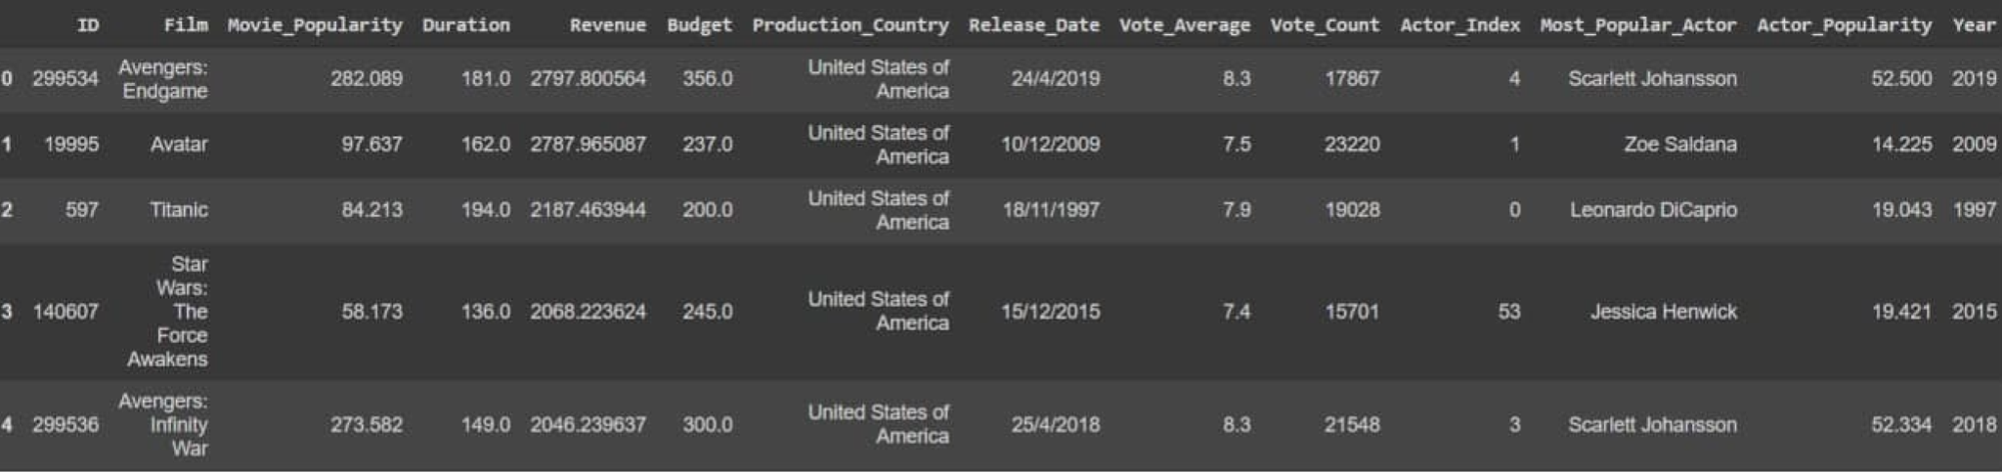
FEATURES
ID
FILM
MOVIE_POPULARITY
DURATION
REVENUE (MIL)
BUDGET (MIL)
PRODUCTION_COUNTRY
RELEASE_DATE
VOTE_AVERAGE
VOTE_COUNT
ACTOR_INDEX
MOST_POPULAR_ACTOR
ACTOR_POPULARITY
YEAR
Notes:
In order to start we first have to extract the data from the TMDB’s movie dataset.After extracting the data, it can be seen there were many features for a movie such as Revenue Budget,Production country etc...But at this stage we’re still not sure if all these features will be used Therefore we will further need to analyse the data.

Slide 7
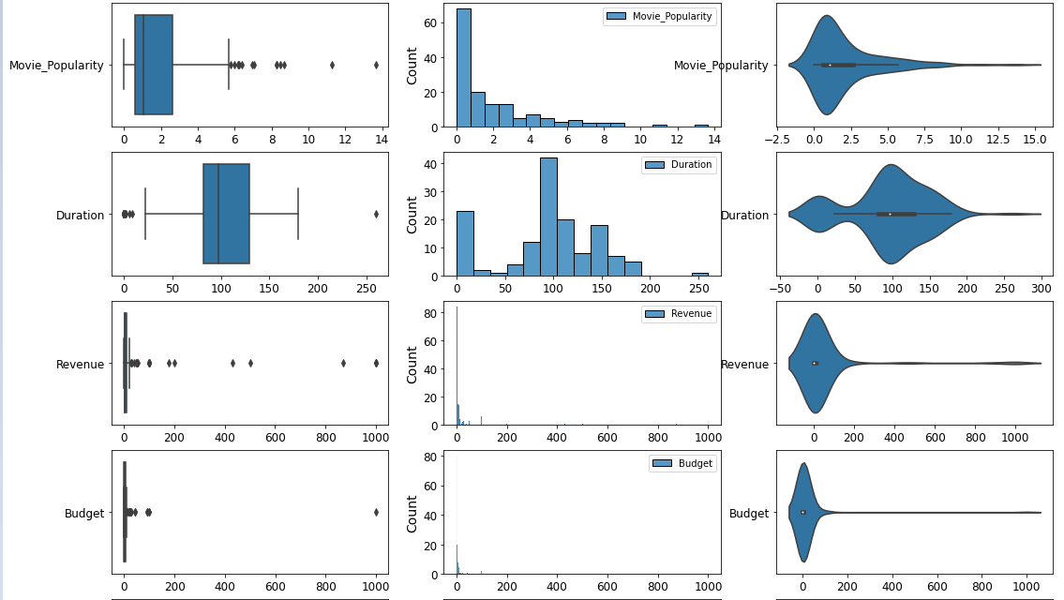
DATA ANALYSIS
Notes:
After building the boxplot,histogram and violin plot to analyse the data,to see if the features have any outliers,skewed or ‘weird’ results.

Slide 8
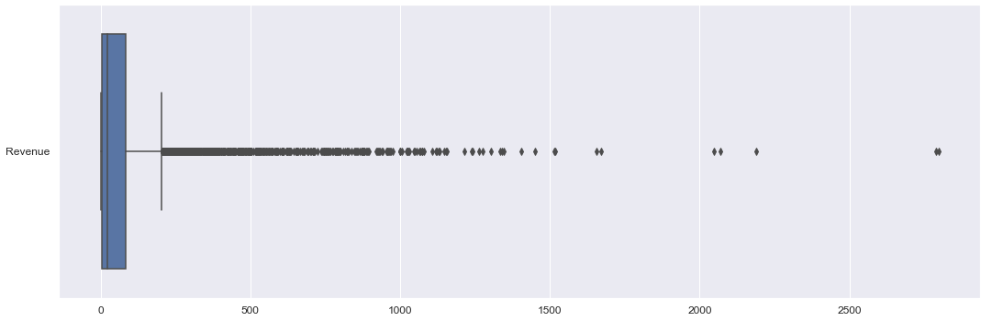
CLOSE UP ON REVENUE
Notes:
Inspecting data,there are a large number of points outside of the whiskers of the box plot for certain features such as Revenue indicating a large number of outliers.

Slide 9
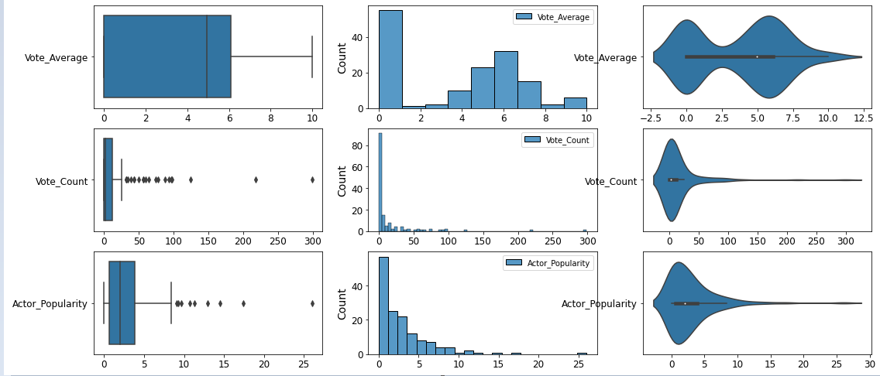
DATA ANALYSIS
Notes:
Further exploratory analysis on the data features to try get an idea on the data behaviour.

Slide 10
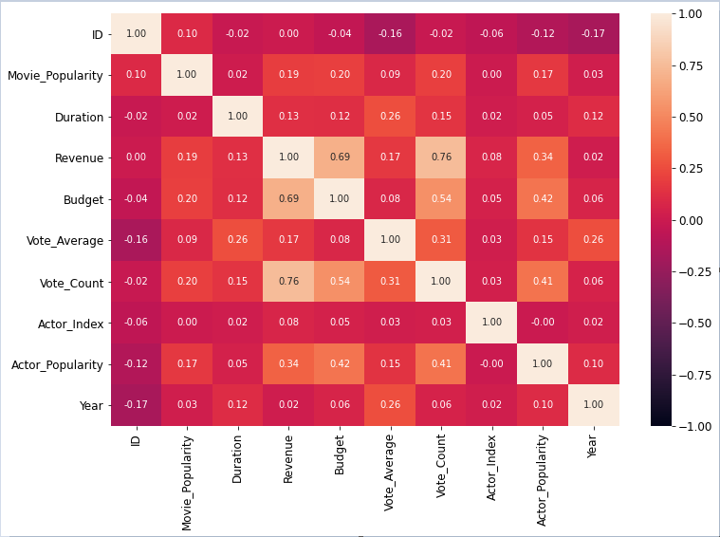
DATA ANALYSIS
Notes:
Using all the numeric values to construct a heat map to see the correlation between the features.From this heat map Vote count, budget and actor popularity seem to have a pretty good correlation with revenue.Columns that have very low correlation to revenue may need to be removed or edited.

Slide 11
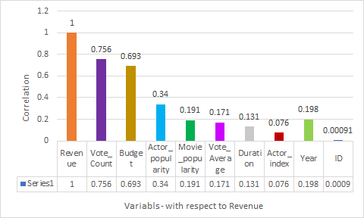
DATA ANALYSIS (REVENUE)
Vote_Count
Budget
Actor Popularity
Seem to have pretty good correlation with Revenue.
Remove columns:
ID
Actor_Index
Year
Categorical or columns that has very low correlation with Revenue.

Slide 12
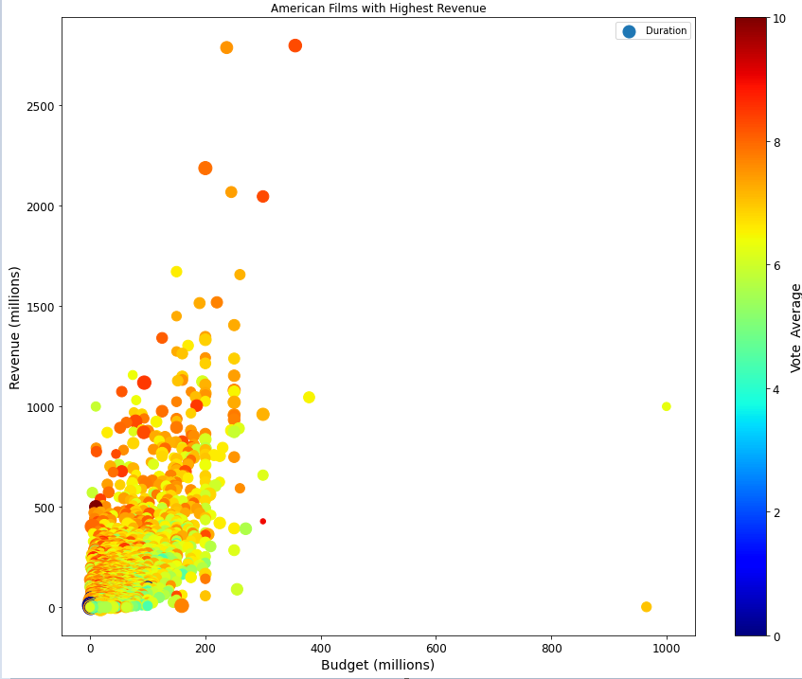
EXPLORATORY ANALYSIS
Colour: Vote Average
X-Axis: Budget
Y-Axis: Revenue
Size of Circle: Duration
Notes:
Building a scatter plot to see if the features ‘Vote average’,’Budget’,’revenue’ has any correlation.From the plot it seems to have quite good correlation but further cleaning and checking of the data need to be done.

Slide 13
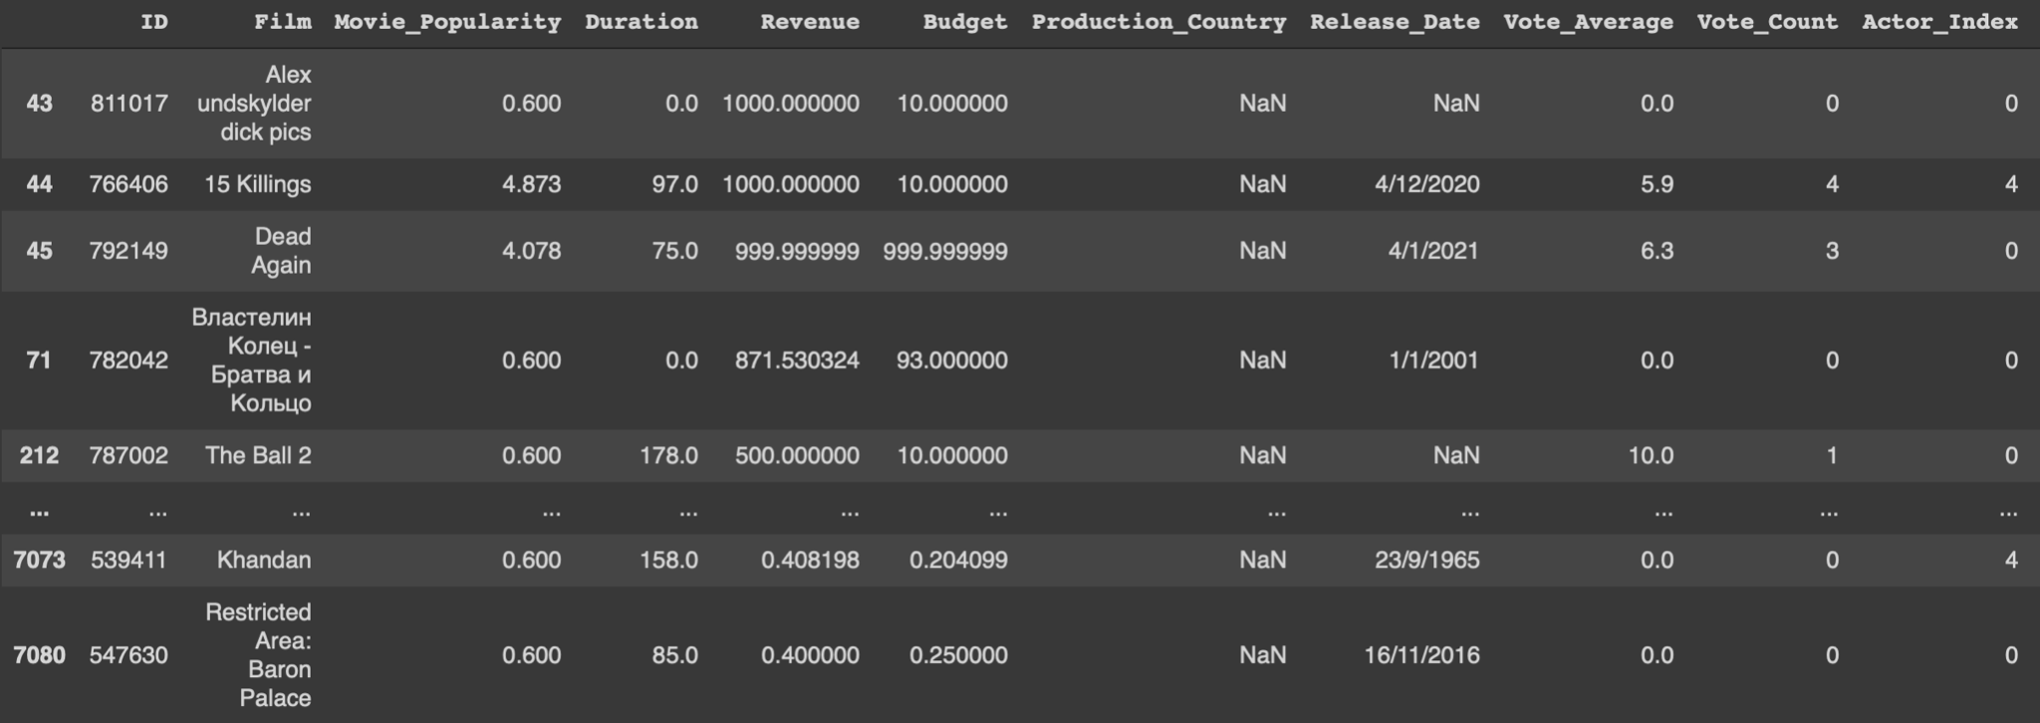
CURATING DATA
Notes:
Decided to drop off the columns that have no importance to predict revenue such as ID, Actor index etc...and closer inspection on the data set again there are missing values in production country and Release date.Or zero entries which made no sense such as movie duration being 0.

Slide 14
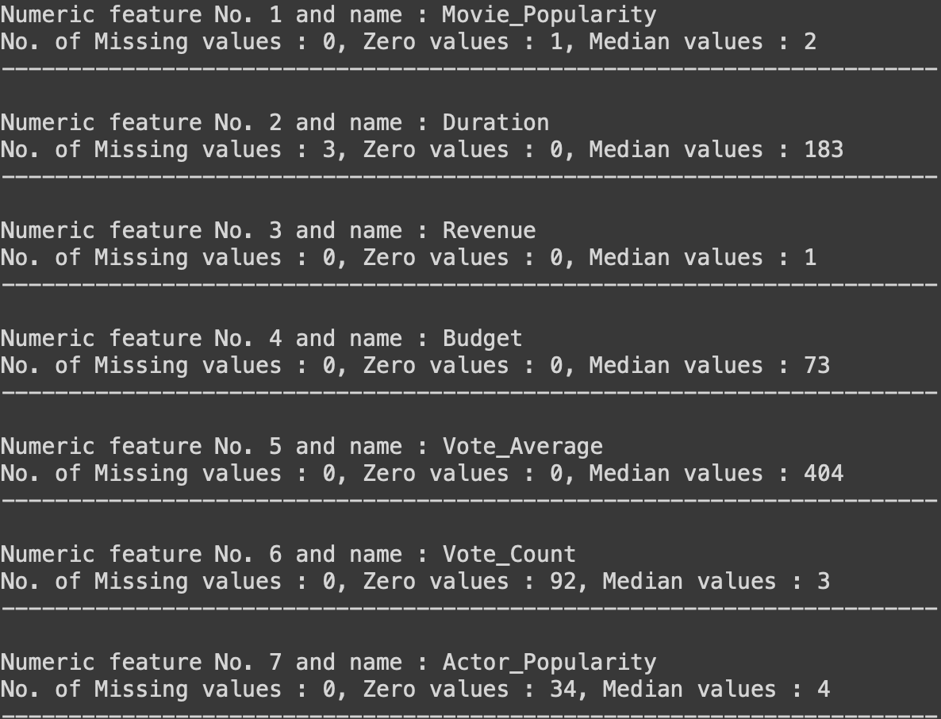
NUMBER OF MISSING VALUES
Notes:
Here is the amount of missing values for each of the features.

Slide 15
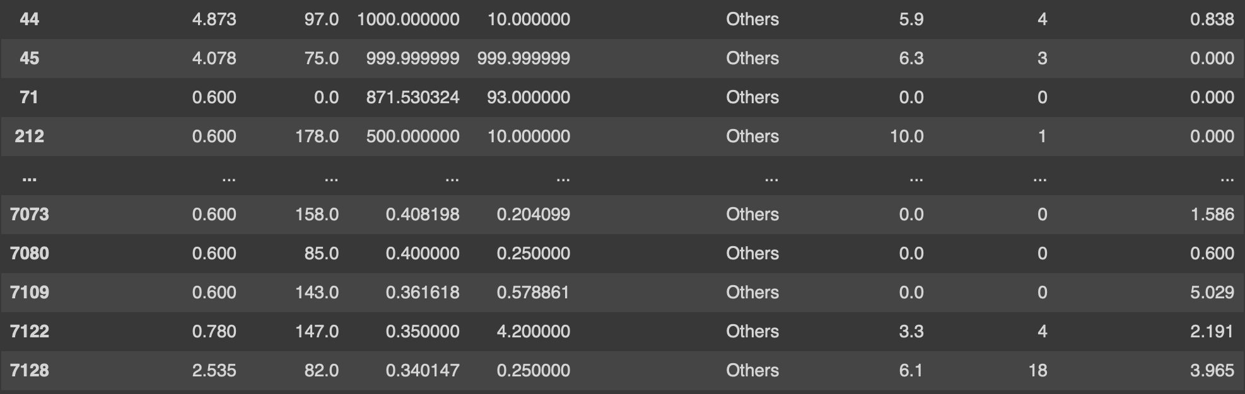
IMPUTER (EXPLAINED IN DATA PREPROCESSING)
Notes:
Find out which features have missing values or 0 values.

Slide 16
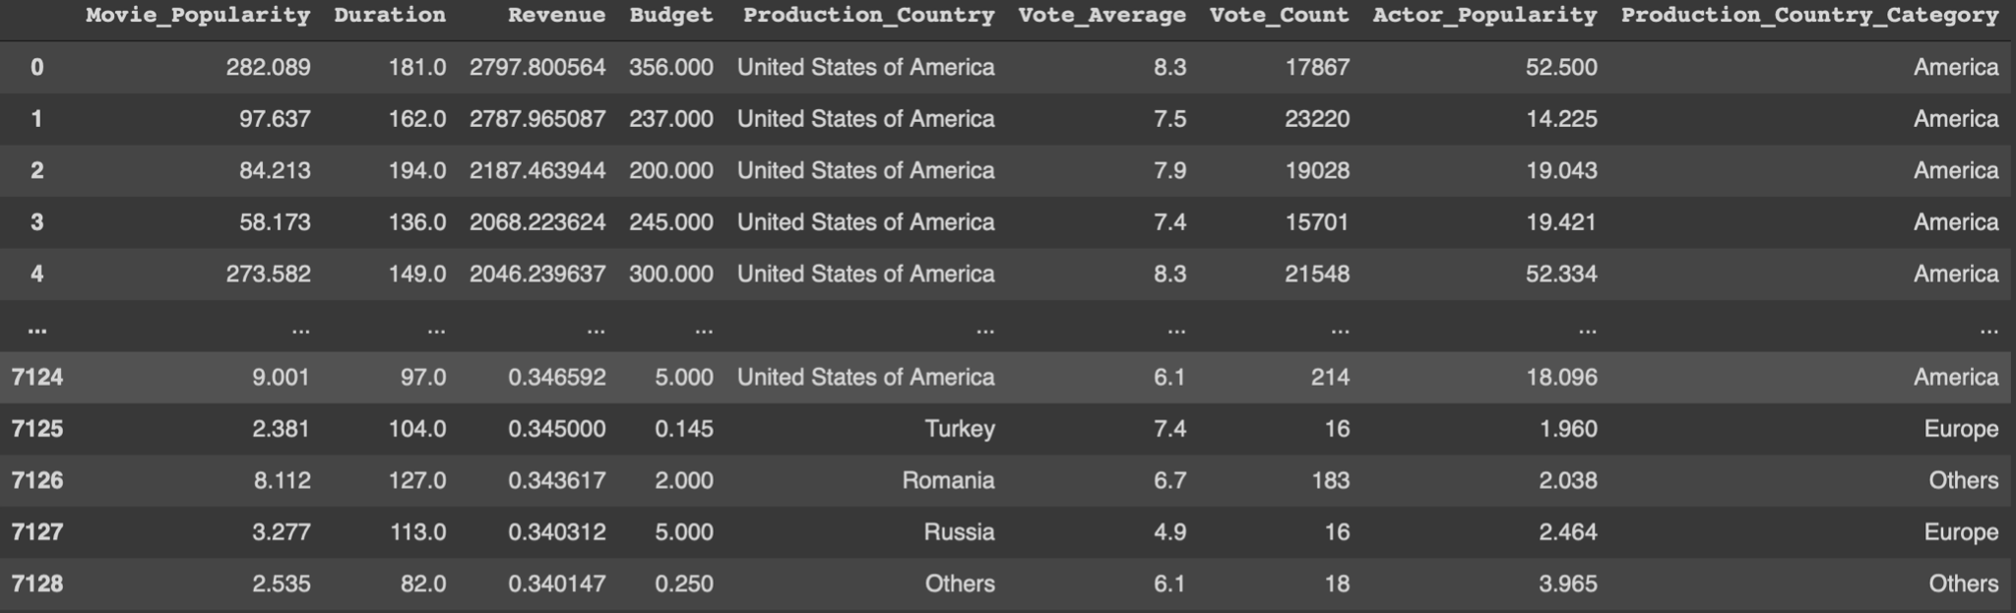
COUNTRY TO REGION
CHANGES INTO
Notes:
For the countries group them into their main region such as America,Europe,Asia,Oceania and others

Slide 17
REGION
100%
75%
50%
25%
0%
60.74%
20.45%
11.15%
5.71%
1.95%
AMERICA
EUROPE
ASIA
OTHERS
OCEANIA

Slide 18
MODELS
Linear Regression, DecisionTreeRegressor, RandomForestRegressor
Notes:
Before we can build the different Machine learning models to find the best model for our data we will need to do some Data Pre-processing.

Slide 19
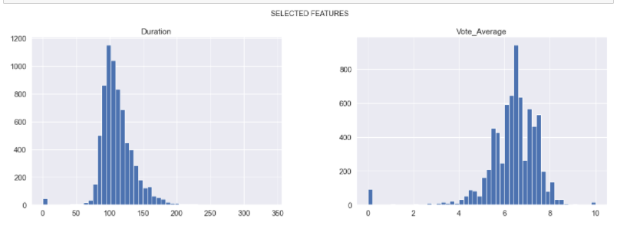
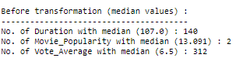
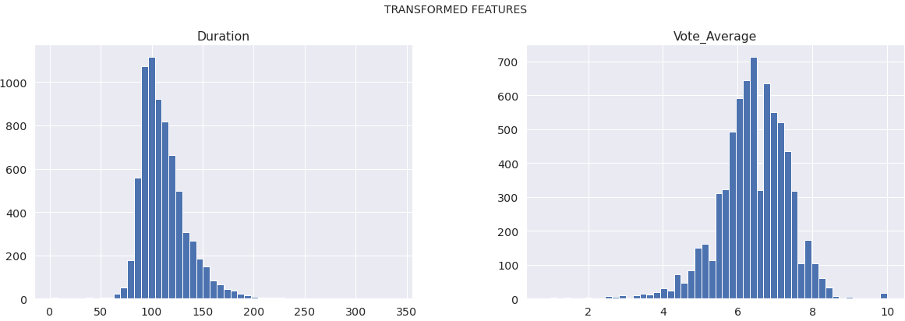
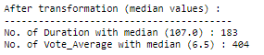
DATA PRE-PROCESSING
Before Replacement
1. Simple imputer (For filling of missing values with median)
2. Replacing of 0 with median for the selected features.
Movie_Popularity
Vote_Average
After replacement
Notes:
For the selected features duration and vote average,Use of simple imputer (For filling of missing values with medianas the 0 values are outliers.Median is chosen as average is affected by outliers and median serves as a better estimate.

Slide 20
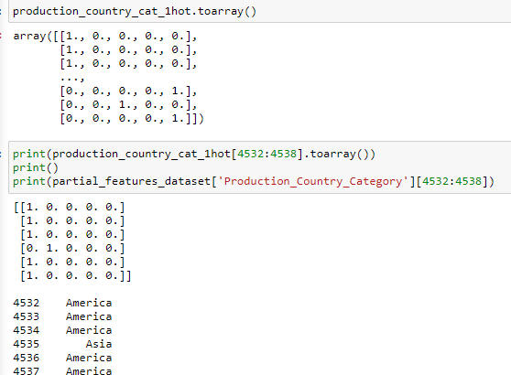
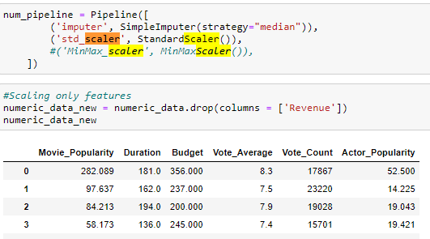
DATA PRE-PROCESSING
One hot encoding for categorical variables (Production Countries)
Standard scaler/ min max scaler
Notes:
For the selected features duration and vote average,Use of simple imputer (For filling of missing values with medianas the 0 values are outliers.Median is chosen as average is affected by outliers and median serves as a better estimate.

Slide 21
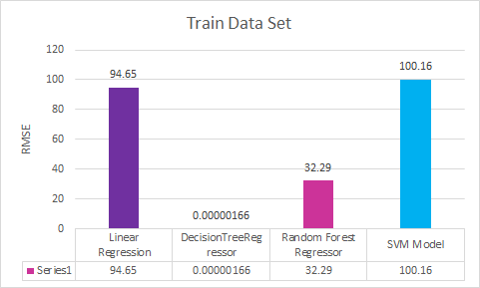
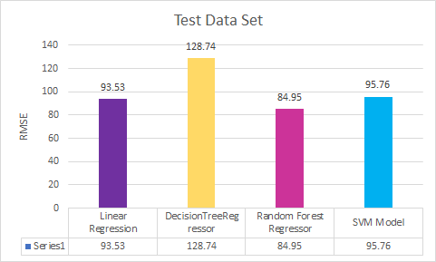
BEFORE HYPERPARAMETER TUNING
Notes:
already gaussian and would scale all features to the same scale for greater accuracy.
Linear Regression:The reason why we choose Linear Regression because our main problem is a linear regression problem due to the numerical values correlating to each other.However, we have categorical features and we want to test if those features affect our problem.
Decision Tree :In general cases, Decision trees will have better average accuracy,for categorical independent variables, decision trees are better than linear regression.However in our case Decision tree train set out performs linear regression train set.However the test set of the decision tree did worse than the linear regression test set could be due to overfitting.As it is good at predicting the train set and not the test,as it can be seen the Decision Tree test set has higher RMSE error than Linear regression Test set.When there are a large number of features with less data-sets(with low noise), linear regressions may outperform Decision trees/random forests.
Random Forest:As Decision trees can be prone to overfitting as seen from the Train Set.Therefore random forest was used instead as it reduces overfitting by aggregating the results of multiple decision trees on the same dataset.That’s because it is a forest of randomly created decision trees. Each node in the decision tree works on a random subset of features to calculate the output. The random forest then combines the output of individual decision trees to generate the final output.
SVM Also tried using SVM, as it is a model used for both classification and regression problems though it is mostly used to solve classification problems.However both the SVM train and test set did not perform better than Random forest.

Slide 22
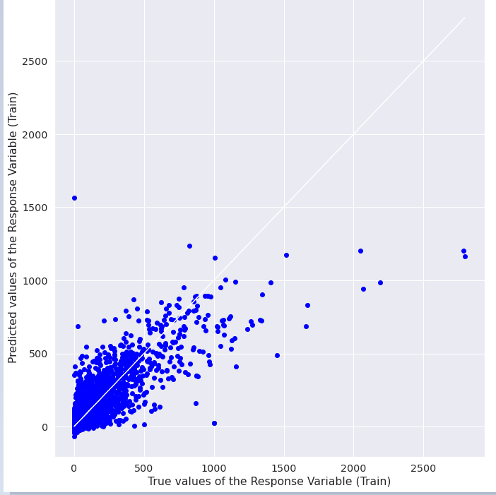
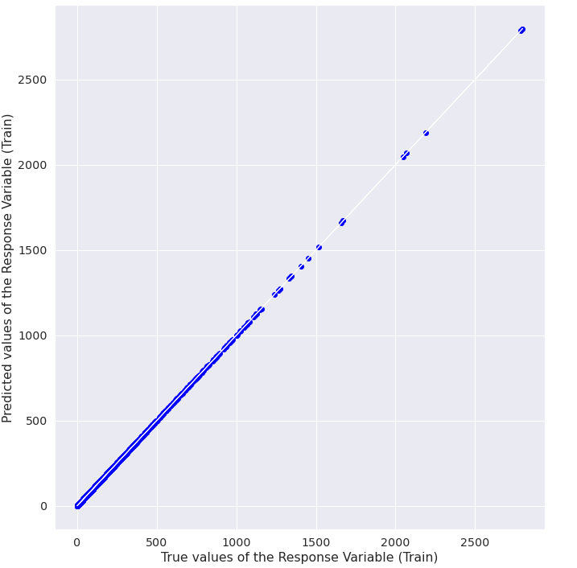
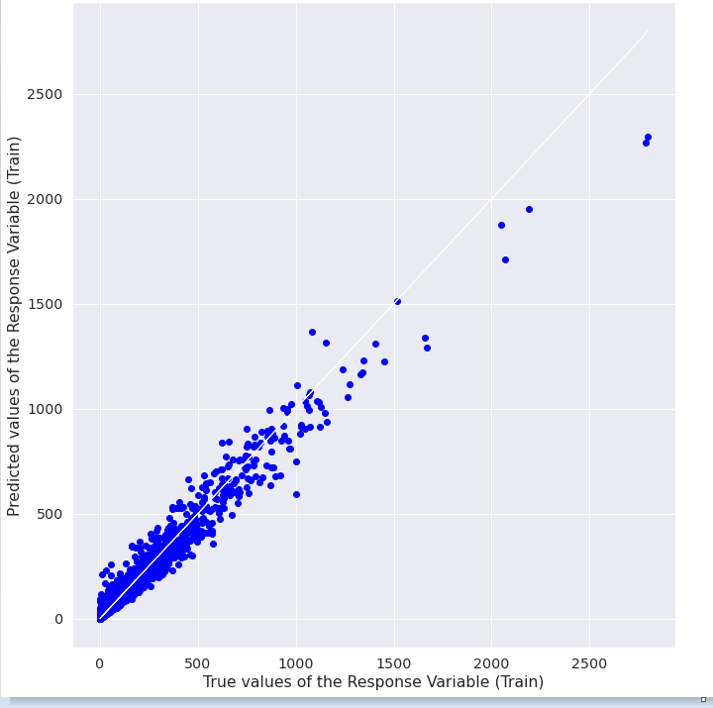
BEFORE HYPERPARAMETER TUNING
Linear Regression
(Train)
Decision Tree
(Train)
Random Forest
(Train)

Slide 23
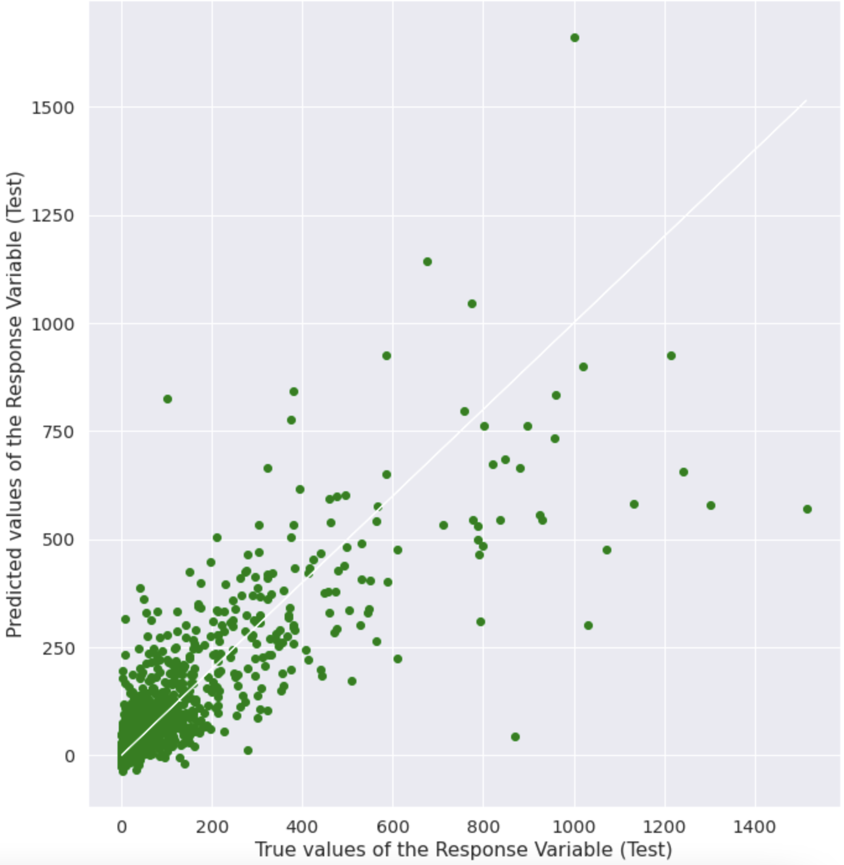
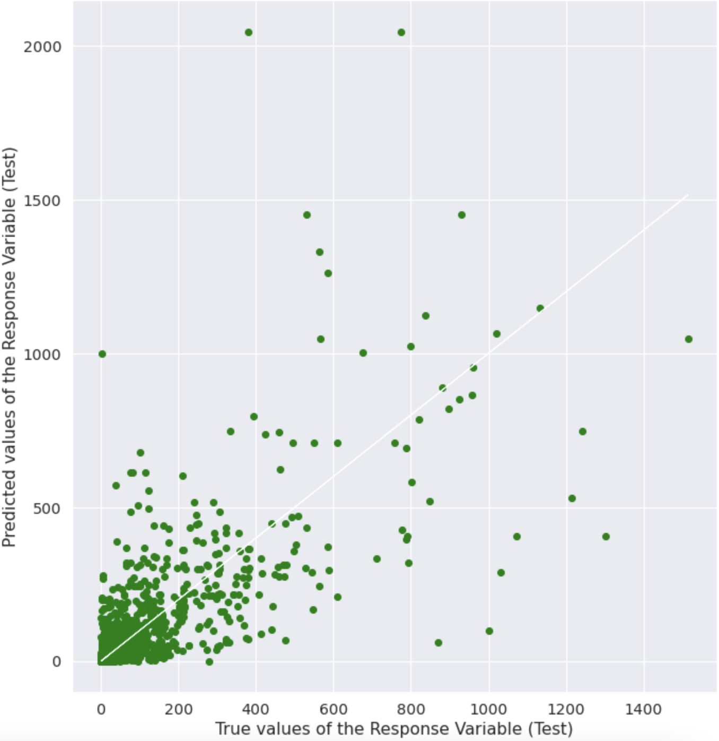
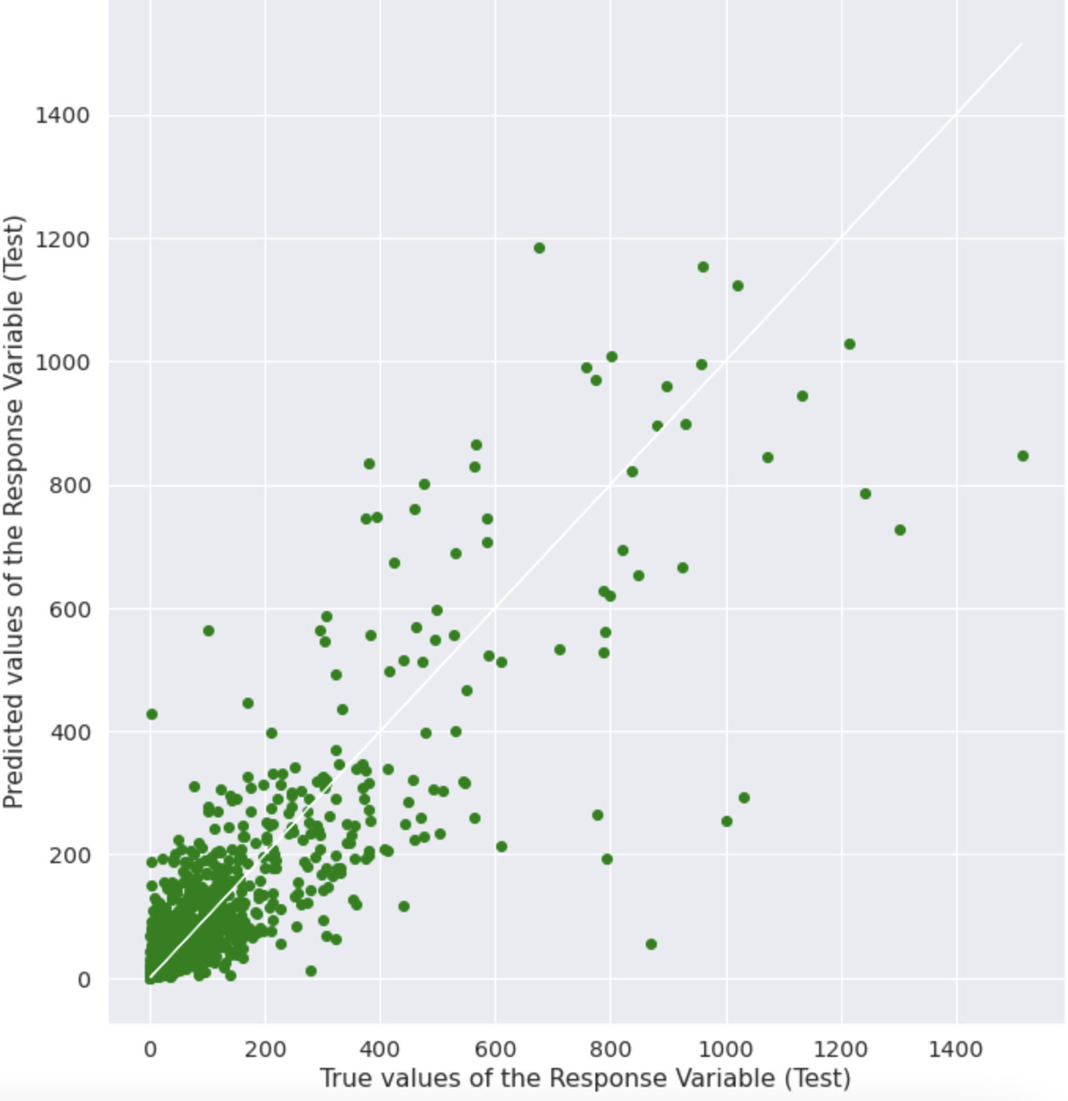
Before HYPERPARAMETER TUNING
Linear Regression
(Test)
Decision Tree
(Test)
Random Forest
(Test)

Slide 24
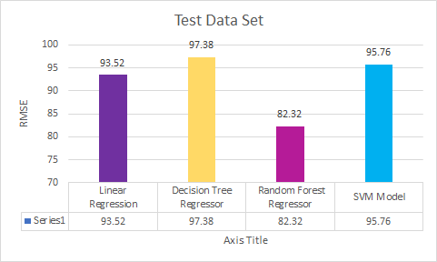
AFTER HYPERPARAMETER TUNING - Test Data Set
Notes:
Hyperparameters tuning is important because they directly control the behaviour of the training algorithm and have a significant impact on the performance of the model being trained.Therefore In order to be sure our model chosen is the best,We did Grid search which trains the algorithm for all combinations by using the two set of hyperparameters (learning rate and number of layers) and measures the performance using “Cross Validation” technique.
In conclusion , Random forest is our best machine model for our problem as it has the lowest RMSE still.

Slide 25
TO ADD ON
HYPERPARAMETERS TUNING
GRID SEARCH

Slide 26
IN CONCLUSION FOR WHICH MODEL IS THE BEST
Notes:
Hyperparameters tuning is important because they directly control the behaviour of the training algorithm and have a significant impact on the performance of the model being trained.Therefore In order to be sure our model chosen is the best,We did Grid search which trains the algorithm for all combinations by using the two set of hyperparameters (learning rate and number of layers) and measures the performance using “Cross Validation” technique.
In conclusion , Random forest is our best machine model for our problem as it has the lowest RMSE still.

Slide 27
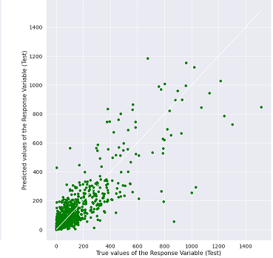
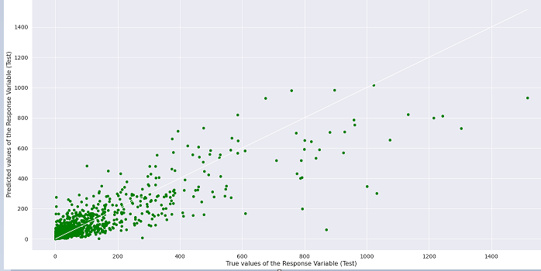
BEFORE AND AFTER HYPERPARAMETER TUNING ON RFR
Before Tuning
After
Tuning
Before Tuning

Slide 28
EXTRA TECHNIQUES

Slide 29
TECHNIQUES
One Hot Decoder
Pipelines
Imputer
Standard Scaler
Feature Scaling
SVM (Support Vector Machine)
Hyper Parameter Tuning
Grid Search
Notes:
For techniques not learn in this course we try/apply techniques such as
One Hot Decoder
Pipelines
Imputer
Standard Scaler
Feature Scaling
SVM
Hyper Parameter Tuning
Grid/Randomised Search

Slide 30
OUTCOME

Slide 31
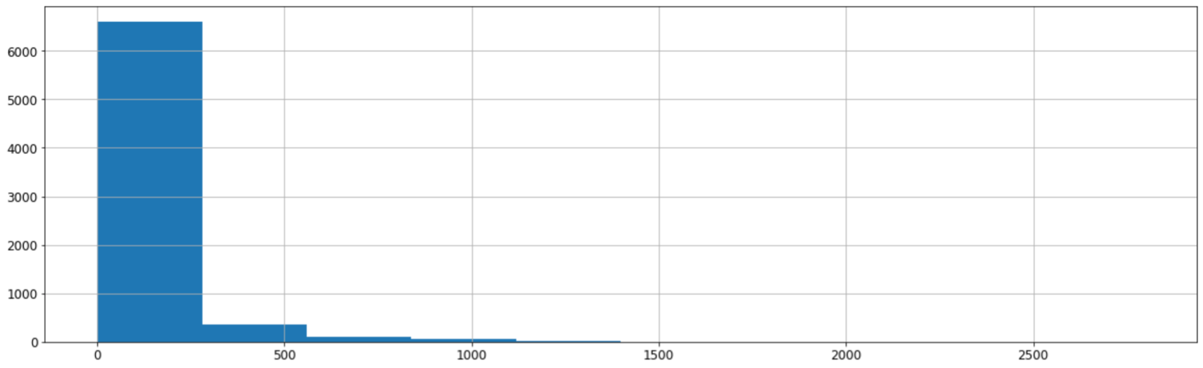
OUTCOME
RandomForestRegressor performs the best.
Feature importance (Vote count most important).
Predicts smaller range revenue better than larger range revenue.
Count
Revenue (millions)
Notes:
RandomForestRegressor gives the best prediction using Vote count to predict Revenue.
From the data we have, it’s best to predict smaller range values compared to bigger range values.
Movie directors or data analysts should take the dataset of vote counts as it heavily correlates to the revenue.
(script)
Outcome,based on all our models used RandomForestRegressor performs the best overall smallest RMSE and VoteCount can be looked into as a primary way to increase revenue.However it is better at predicting smaller range of revenue better than larger range

Slide 32
INSIGHTS AND RECOMMENDATIONS
Notes:
Lastly on insights and recommendations.

Slide 33
INSIGHTS
Movie companies to look into vote count.
Low correlated features are as important. Different models works better with different types of features.
Data collection/extraction on variables (EG Revenue) can be improved.
Conducting a seperate machine learning on outliers
Notes:
Vote count as the best feature due to its high correlation to revenue.
Low correlated features are just as important when using RFR as removing them causes the RMSE to increase. The scripts is below, okay
Linear regression model works better with higher correlated features while DecisionTreeRegressor and RandomForestRegressor works better with independent features.
Alternatively, we can view it as a classification problem by using stratified sampling to split the data set proportionally to each features. This can be done by splitting the “numerical” values into “categorical” values using bins and cutting them according to the mean.
(script)
Firstly our insights are,
Vote Count as one of the best features.
Low correlated features are as important.
Removing low correlated features improves decisiontreeregressor and randomforestregressor but deproves linear regression.
Different graphs work better with different types of features.
Possible to use classification to solve this problem.

Slide 34
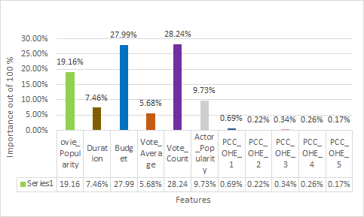
FEATURE IMPORTANCE

Slide 35
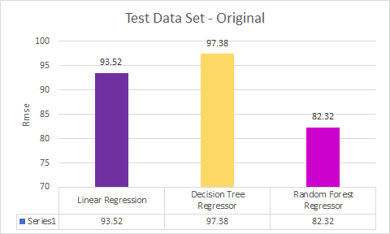
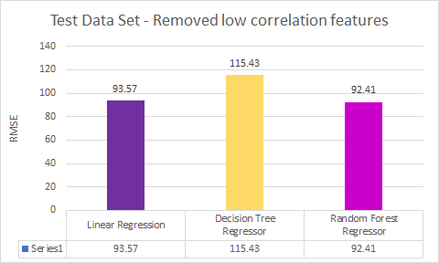
LOW CORRELATION FEATURES
NOTE: Small typo in the
Presentation vid (6min 44s)
Testing effect on accuracy after removing low correlation features/predictors.
Removed 'Duration', 'Vote_Average', 'Movie_Popularity'
Notes:
Comparing on Hyperparameter Tuning - Test Data set,
Before and after removing low correlation features, the Overall RMSE decreases for all three model,therefore low does not mean no correlation

Slide 36
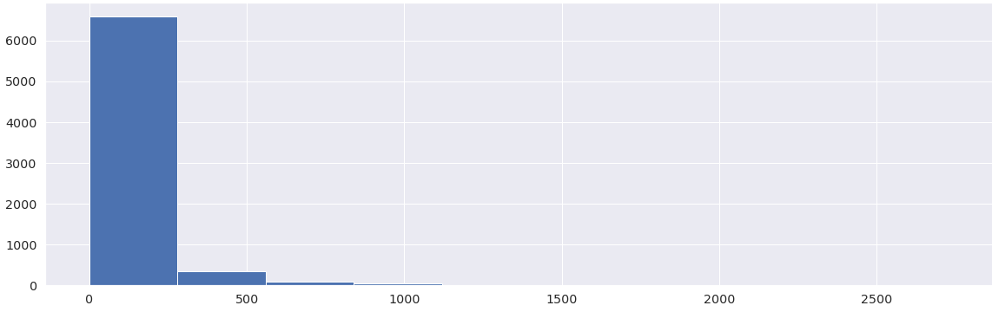
LIMITATIONS
Revenue is left skewed
Lack of data
Count
Revenue (millions)
Notes:
As revenue is left skewed, it will raise the RMSE value due to the lack of data in areas of high revenue.
A good data size we felt is to be around 10,000. Due to the lack of data, it leads to very overfitted training dataset which leads to bad predictions on test set.
Presence of large amount of outliers will affect RMSE as the outliers affects the mean of the dataset, potentially increasing the RMSE value on our prediction.
(script)
Certain limitation discovered,
Revenue is left skewed, it will raise the RMSE value due to the lack of data in areas of high revenue.
A good data size we felt is to be around 10,000. Due to the lack of data, it leads to a very overfitted training dataset which leads to bad predictions on the test set.
Huge number of outliers will affect the mean value of the data,potentially increasing the RMSE value on our prediction.

Slide 37
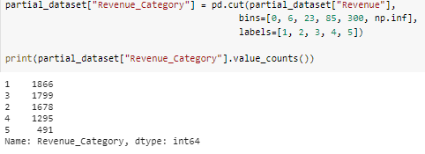
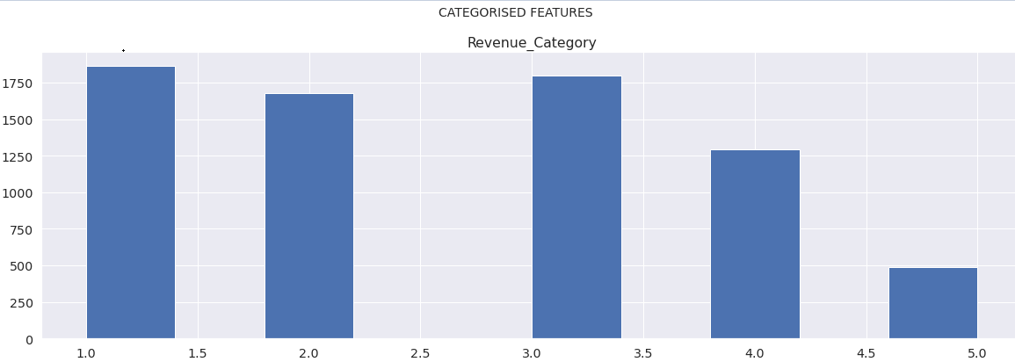
STRATIFIED SAMPLING

Slide 38
Conduct another Machine Learning for outliers
Notes:
After building the boxplot,histogram and violin plot to analyse the data,to see if the features have any outliers,skewed or ‘weird’ results.

Slide 39



CREDITS
Roydon
Data Extraction
Data Pre-Processing
Machine Learning Models
Editor
Bryan
Exploratory Analysis
Machine Learning Models
Slides
Jun Jie
Exploratory Analysis
Machine Learning Models
Presenter

Slide 40
REFERENCES
Free4kwallpapers.com. 2021. Movie 4K wallpapers for your desktop or mobile screen free and easy to download. [online] Available at: <https://free4kwallpapers.com/movie-wallpapers> [Accessed 22 April 2021].
DEV Community. 2021. How to Use the TMDB API to Find Films with the Highest Revenue. [online] Available at: <https://dev.to/m0nica/how-to-use-the-tmdb-api-to-find-films-with-the-highest-revenue-82p> [Accessed 22 April 2021].
GitHub. 2021. ageron/handson-ml2. [online] Available at: <https://github.com/ageron/handson-ml2/blob/master/02_end_to_end_machine_learning_project.ipynb> [Accessed 22 April 2021].
Mlcorner.com. 2021. Linear regression vs decision trees. [online] Available at: <https://mlcorner.com/linear-regression-vs-decision-trees/> [Accessed 22 April 2021].
Use?, D. and Sharma, A., 2021. Decision Tree vs. Random Forest - Which Algorithm Should you Use?. [online] Analytics Vidhya. Available at: <https://www.analyticsvidhya.com/blog/2020/05/decision-tree-vs-random-forest-algorithm/> [Accessed 22 April 2021]..
SlidesCarnival. 2021. SlidesCarnival: Best Free PPT Templates and Google Slides Themes. [online] Available at: <https://www.slidescarnival.com/> [Accessed 23 April 2021].
Unsplash.com. 2021. Beautiful Free Images & Pictures | Unsplash. [online] Available at: <https://unsplash.com/> [Accessed 23 April 2021].
Lucid Illustrations. 2021. Lucid Illustrations. [online] Available at: <https://lucid.pixsellz.io/> [Accessed 23 April 2021].O’Reilly Online Learning. 2021. Hands-On Machine Learning with Scikit-Learn, Keras, and TensorFlow, 2nd Edition. [online] Available at: <https://learning.oreilly.com/library/view/hands-on-machine-learning/9781492032632/ch07.html> [Accessed 23 April 2021].
Notes:
Free4kwallpapers.com. 2021. Movie 4K wallpapers for your desktop or mobile screen free and easy to download. [online] Available at: <https://free4kwallpapers.com/movie-wallpapers> [Accessed 22 April 2021].

Slide 41
THANK YOU

